Slide 1


Marketing Presentation for
Presenter: Shirley Tham Hau Kum, 244A
GLH.com.sg

Slide 2
Marketing Brief

Slide 3





Company Background
Guan Lee Hoe Engineering Pte Ltd. was founded in 1995 started of as a subcontractor handling aircon installation for residential projects.
With a track record of 29 years in the industry it has expanded its services to office, retail and industrial sectors for aircon design consultancy, fabrication, installation, maintenance as well as office renovation.
Over the years, Guan Lee Hoe Engineering Pte Ltd has been awarded bizSAFE Level STAR and OHSAS 18001 Certifications.
Its portfolio includes mega projects for clients like Capitaland, Mapletree, Far East Organization, etc…

Slide 4
Core services
Commercial Aircon advisory, consultancy* & design with latest ACMV (Aircon & Mechanical Ventilation), HVAC (Heating and Ventilation Aircon) technologies and equipments
Aircon fabrication
Aircon installation
Aircon maintenance
Renovation for new or upgrading of commercial spaces (Offices, Retail & Industrial)
Helps obtain BCA Green Mark thereby achieving up to 50% reduction in electricity bills https://www1.bca.gov.sg/buildsg/sustainability/green-mark-certification-scheme
* Consultation for existing ACMV / HVAC systems (oversized) & help determining the right size system requirement, install the relevant equipment to reduce condensation resolving why aircon is too cold and save electricity bills by up to 20%
Save at least 20% - 50% of energy consumption

Slide 5
Unique Selling Proposition
Vince, the founder, boasts an impressive 10-year tenure with one of Japan's top three commercial aircon contractors. This extensive experience and exposure to cutting-edge aircon technology has positioned him at the forefront of the industry.
The company collaborates with associates who are certified Green Mark Managers, ensuring environmentally sustainable ACMV, HVAC and eco-friendly solutions that meet the highest standards.
Guan Lee Hoe Engineering Pte Ltd also engages in office renovations, making it a one stop solution for relocation needs.

Slide 6

Marketing Plan

Slide 7
Executive Summary
Business Objective: To increase sales turnover by 10% in the next six months
New target market: Small medium enterprises planning to shift office locations or to upgrade to better air-cooling systems to help save costs by reducing carbon footprint
Market need: With global warming, there is a growing need for cooling aircons which are energy savings to reduce carbon footprint.
Service Overview: To promote installation of energy saving aircons and assist building to be Green Mark certified by BCA

Slide 8
Executive Summary
Market Strategy: Awareness - Use Facebook and Instagram to create brand awareness
- SEM : run google ads campaign to appear at top of search
results when customers search
Interest - Optimize landing page content to rank higher in search engine
results and attract more visitors
Desire: - Highlight positive reviews and excellent service on landing page and
social media to win trust and create a desire to purchase. Offers free
first time consultation
Action : Call to action must be clear. Lead capture form on landing page to get
their contacts and reach out to their interests

Slide 9
SWOT Analysis

Slide 10
SWOT Analysis of Guan Lee Hoe Engineering
A) Strength
Specialization in aircon services: offering top notch services in the aircon engineering industry
Quality workmanship: it prides itself on providing excellent customer service and quality workmanship ensuring customer satisfaction. It has achieved BizSafe Star status and ISO certification. This shows how much emphasis is placed on safety and quality standards and is a plus point to earn potential customers’ trust
Expert team: With a foundation dating back to 1995, the company has accumulated significant experience and had built a team of experts dedicated to meeting engineering needs

Slide 11
SWOT Analysis of Guan Lee Hoe Engineering
B) Weaknesses
Prominence: Competitors do own alternate related business and is exhibited in their websites impressively and informatively. For instance, Paw Leck Engineering - it owns an e-shop selling many ducting and aircon parts. Its website featured many photos of the spare parts, certainly stand out amongst its competitors
Promotion: Its competitor, Letscoolaircon, offers many kinds of freebies like free installation, free site survey which are highly attractive for potential customers. Guan Lee Hoe Engineering should also kickstart to offer freebies or discounts to attract potential customers
Happy customers’ reviews: Letscoolaircon registered 25,000 Happy customer reviews verified by 4.9 google rating and 5.0 Facebook rating. With such high ratings, it is no wonder that they are found on first page of google search. Guan Lee Hoe Engineering can emulate it too
C) Opportunities
Growing demand: Due to government push for sustainability, IT / digital centric economy and climate change as weather gets warmer, Guan Lee Hoe Engineering still can play its part in meeting growing demand by helping potential customers to install energy saving aircons,
Market Expansion: Target new market segments within the commercial and industrial installation sectors to capitalize on emerging trends e.g. data centre

Slide 12
SWOT Analysis of Guan Lee Hoe Engineering
D) Threats
Competition: Competition is a threat to Guan Lee Hoe’s market share and profitability
Price: Price undercut with lots of promotion and various after sales services
Technology : Rapid advancement of HVAC technology requires continuous learning and adaptation
: Automation, Ai, Internet of Things driven solutions disrupt traditional models
Environmental Regulations: Stricter environmental regulations regarding refrigerants, emissions, green
energy may result in increase operation costs and require changes in business practices

Slide 13
Ideal Persona

Slide 14
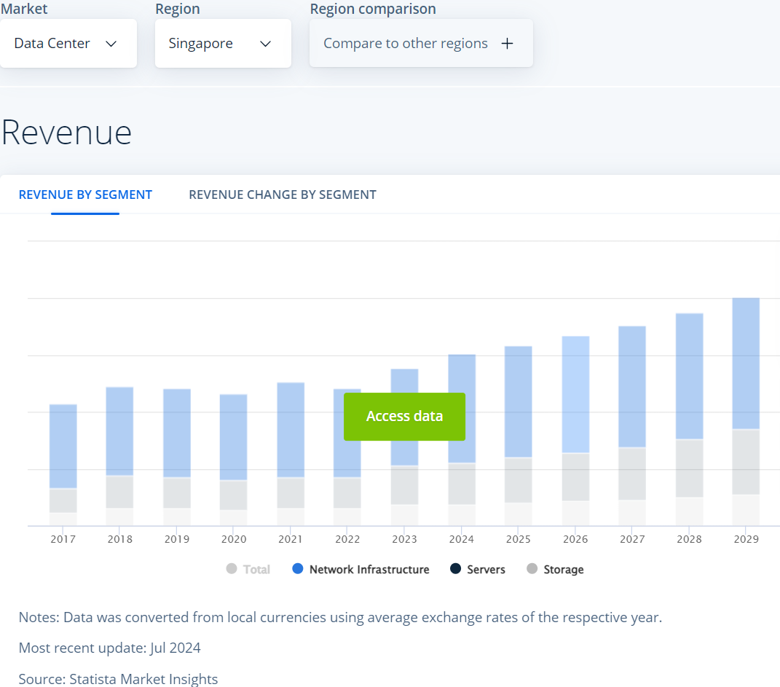
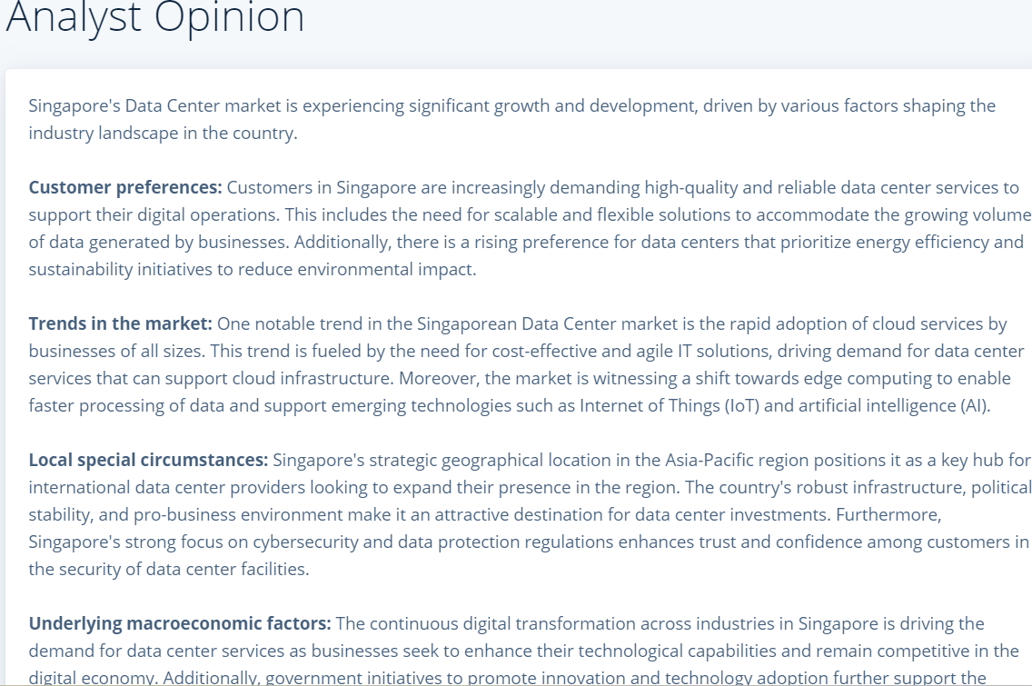
Ideal Persona
Notes:
Singapore’s data center market is experiencing significant growth, there is market potential to tap for aircon industry as it consumes much energy and Guan Lee Hoe Engineering can render its expertise in energy savings

Slide 15
Ideal Persona
Demographic Information
Name | Michael Lim
Age | 40
Occupation | CEO of an SME IT company offering services to banks
Education Level | Masters degree in Computer Science
Location | Singapore
Single or Married? Any kids? | Married
Income Level | SGD 120k annually
Notes | Detail oriented, tech savvy, value efficiency

Slide 16
Ideal Persona
Psychographic Information
Life stage | Established in career, focused on optimizing operations
Pain Points | - Increase in staff headcount - Increase in office rent after Covid-19 - Increase in electricity prices for AC system to cool internal data-centre / server room - Managing energy consumption, minimizing system downtime
Motivations | - Ensuring staff have enough space to work - Reducing operational (rental and electricity) costs
Challenges | - Ensuring regulatory compliance
Core Values & Beliefs | Reliability, innovation, data availability

Slide 17
Ideal Persona
Service Needs & Preferences
Online Behavior | Active on tech forums, researches extensively before making decisions
Preferred Communication Channels | Email, virtual meetings for detailed discussions
Service Expectations | Quick response times, customised solutions, proactive maintenance
Price Sensitivity | Pay for quality, fair pricing and excellent aftercare maintenance services

Slide 18
Ideal Persona
Decision Making Process
Information Sources | Tech publications, industry conferences, online forums
Influencers | Industry experts, IT solution providers
Barriers to entry | High initial investments, trust in service providers
Decision Triggers . | Energy-efficient solutions, reliable services, cost effectiveness

Slide 19
Competitive Analysis

Slide 20
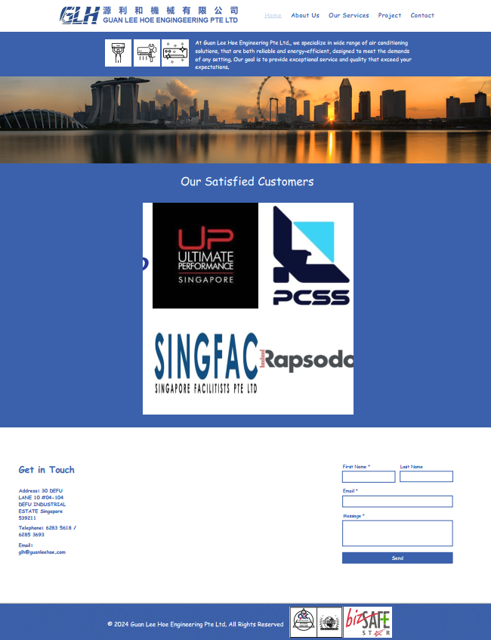
Competitive Analysis – Website
Current website
https://www.glh.com.sg
Pros:
Contact form
Listing their projects with major clients and certification logos.
Cons
Unable to decipher services provided at a glance.

Slide 21
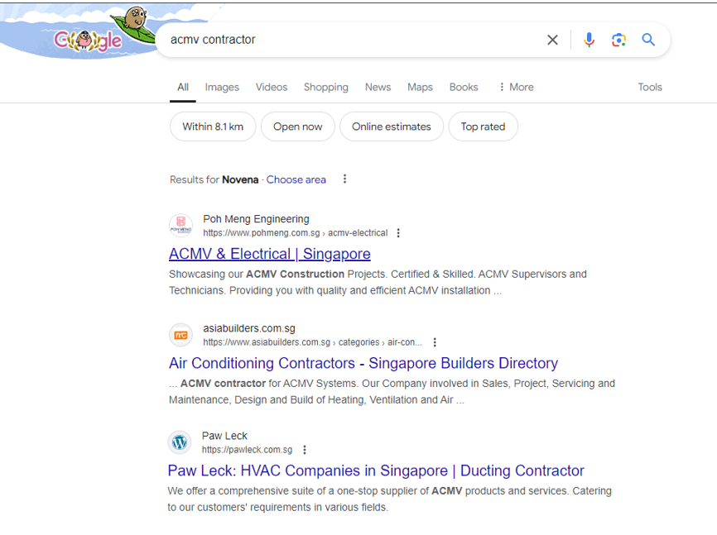
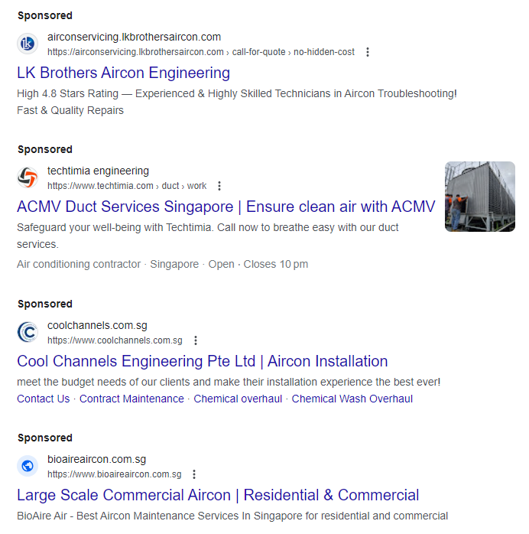
Competitive Analysis – Website
Google keyword search on “ACMV contractor”
Guan Lee Hoe Engineering Pte Ltd. Is not on the
top / first page of results.

Slide 22
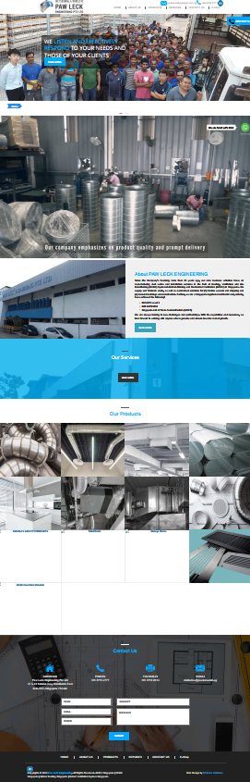
Competitive Analysis – Website
Competitor website #1
https://pawleck.com.sg
Pros
Corporate video
Showcase manufacturing materials
Online Shop
Whatsapp
Con
Did not show list of clients

Slide 23
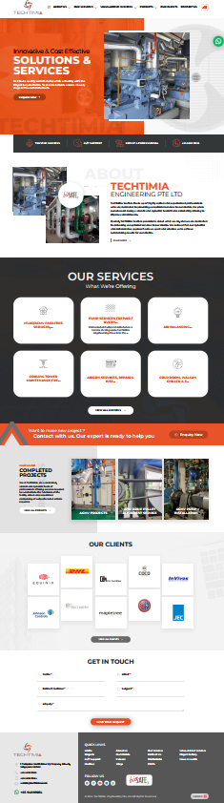
Competitive Analysis – Website
Competitor website #2
https://www.techtimia.com
Pros
Bold colors and dynamic elements (rotating fan)
Displays pictures of past projects
Shows services Techtima provide
WhatsApp button for contact
Cons
Does not show quality and safety certification logos but awards only

Slide 24
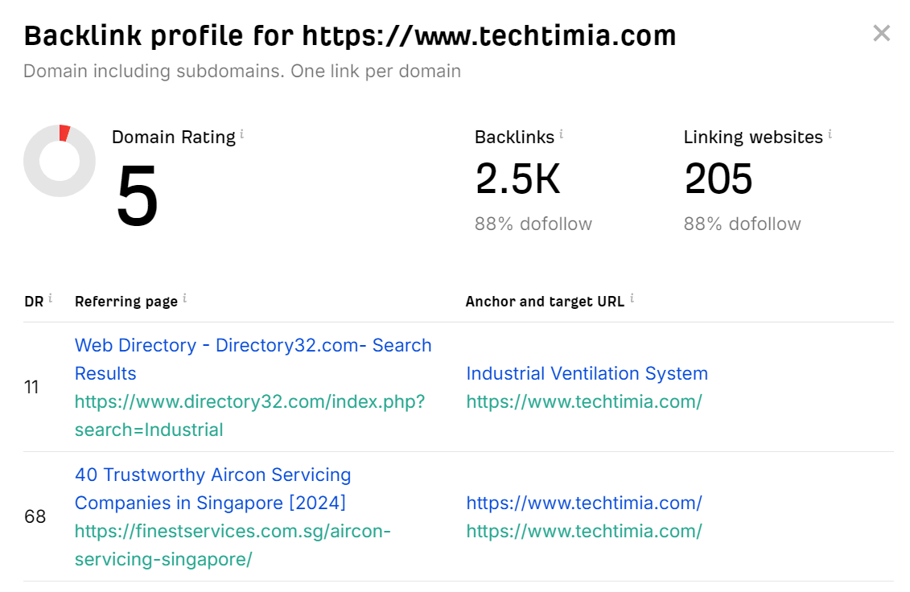
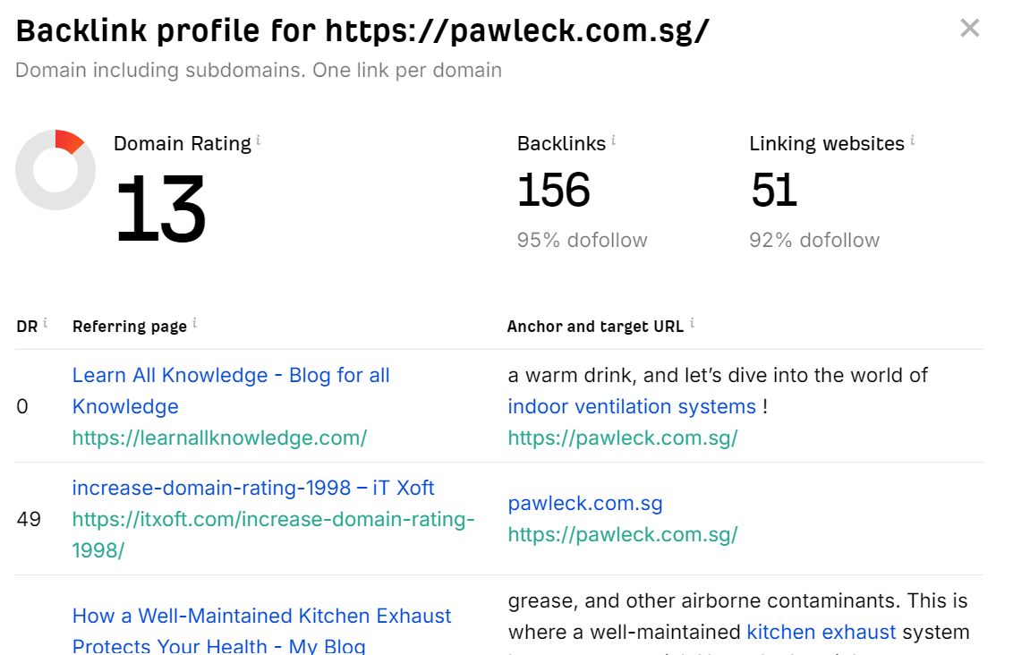
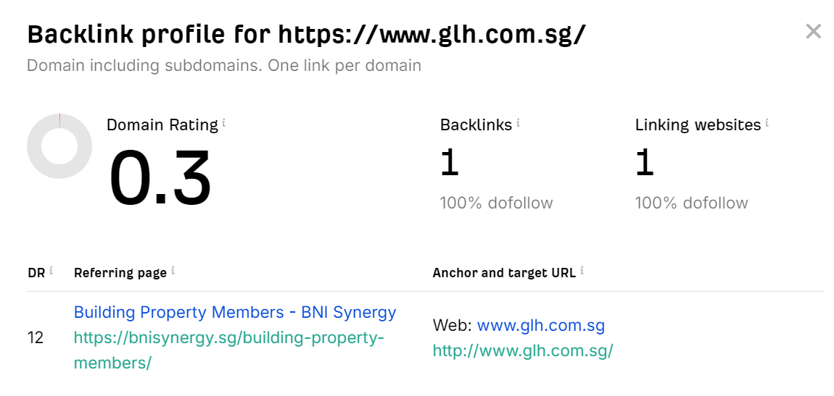
Competitive Analysis – Website
Backlink checker with ahrefs.com
Competitor website #1
https://pawleck.com.sg
Competitor website #2
https://www.techtimia.com
Conclusion
GLH doesn’t have enough backlinks hence not noticeable on Google search &
Why Backlink is important?
Backlinks signal to search engines like Google that your content is valuable, increasing your website's visibility and ranking.

Slide 25
Competitive Analysis – Website
Category | Area of comparison | https://www.glh.com.sg | https://pawleck.com.sg | https://www.techtimia.com
Design and Usability | User Interface (UI) Design | Basic static UI, font maybe too unprofessional | Corporate video, professional look | Visually captivating colors, Dynamic marquee
 | User Experience (UX) | Not intuitive, (Project-> Renovation, don’t know pictures can click to reveal more) | Easy to navigate | Easy to navigate
 | Mobile Responsiveness | Responsive | Responsive | Responsive
Content | Quality and Relevance | Relevant | Relevant | Relevant
 | Content Strategy | Information hidden and brief | Emphasizes on manufacturing processes and R&D | Provides articles on product maintenance

Slide 26
Competitive Analysis – Website
Category | Area of comparison | https://www.glh.com.sg/ | https://pawleck.com.sg | https://www.techtimia.com
SEO and Visibility | Keywords and Optimization | Little mention of ACMV or HVAC, good metadata | HVMC in page title HVAC/ACMV words extensively used | HVAC/ACMV words are used
 | Backlink Profile | Domain: 0.3 Backlinks: 1 Linking website: 1 | Domain: 13 Backlinks: 156 Linking website: 51 | Domain: 5 Backlinks: 2500 Linking website: 205
Technical Performance | Site Speed | < 3ms | > 3ms | < 3ms
 | Security (HTTPS) | Yes | Yes | Yes
Social Media Presence | Integration and Activity | No social links | Broken LinkedIn button link | Social media buttons not working except for WhatsApp

Slide 27
Competitive Analysis – Website
Category | Area of comparison | https://www.glh.com.sg/ | https://pawleck.com.sg | https://www.techtimia.com
Marketing Tools | Use of Analytics | None | No data | No data
 | Email Marketing Integration | None | No data | No data
Customer Engagement | Reviews and Testimonials | None | None | None
 | Interactive Elements | Contact us form | Contact us form Whatapp button Online Shop | Contact us form WhatsApp contact

Slide 28
Competitive Analysis – Social media
 | Facebook | Instagram | TikTok
Guan Lee Hoe Engineering Pte Ltd | Presence | No Presence | No Presence
Paw Leck Engineering Pte Ltd | Presence | Presence | No Presence
Techtimia Engineering Pte Ltd | Presence | No Presence | No Presence
Facebook has approximately 3.70 million active users in Singapore. *
Instagram has approximately 3.15 million active users in Singapore. *
Utilizing social media is vital for business growth, as it enables companies to expand their reach to new and untapped customer bases, drive organic traffic and open new markets to get leads
Each social media platform is suited for different marketing goals and target audiences. It is important to understand and leverage on their features:
Facebook: Enhance customer engagement, building brand loyalty
Instagram: High visual appeal and high user engagement
TikTok: Increasing brand awareness
* https://datareportal.com/reports/digital-2024-singapore

Slide 29
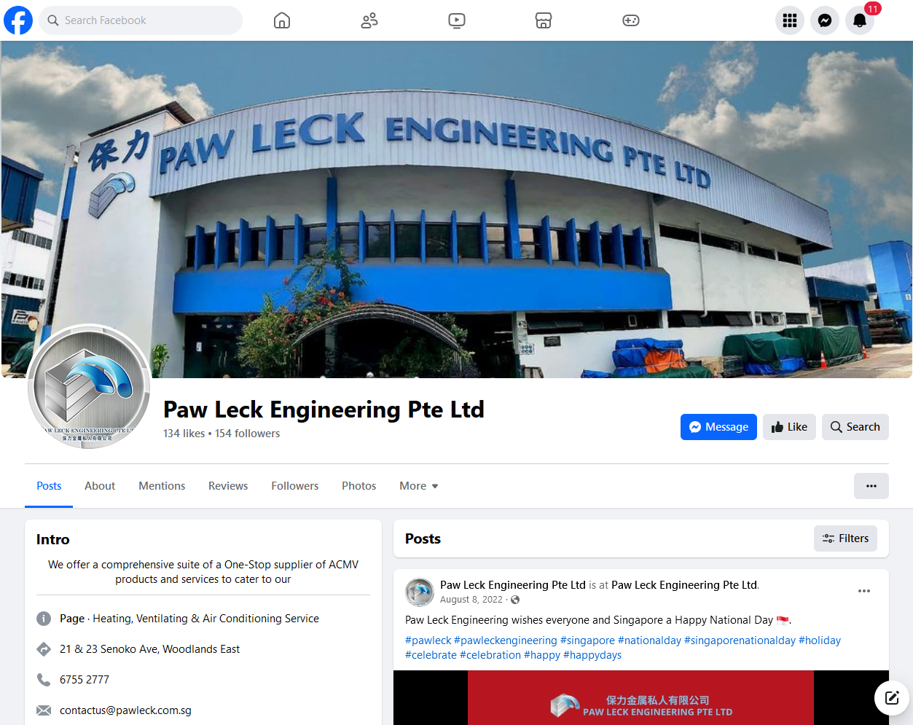
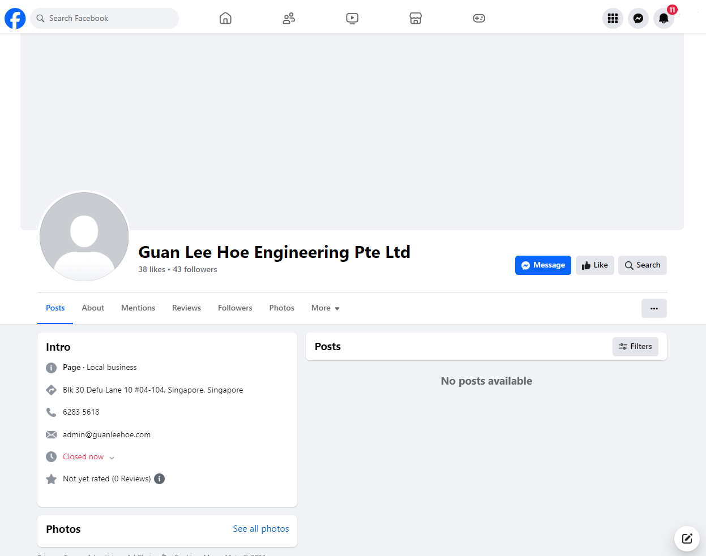
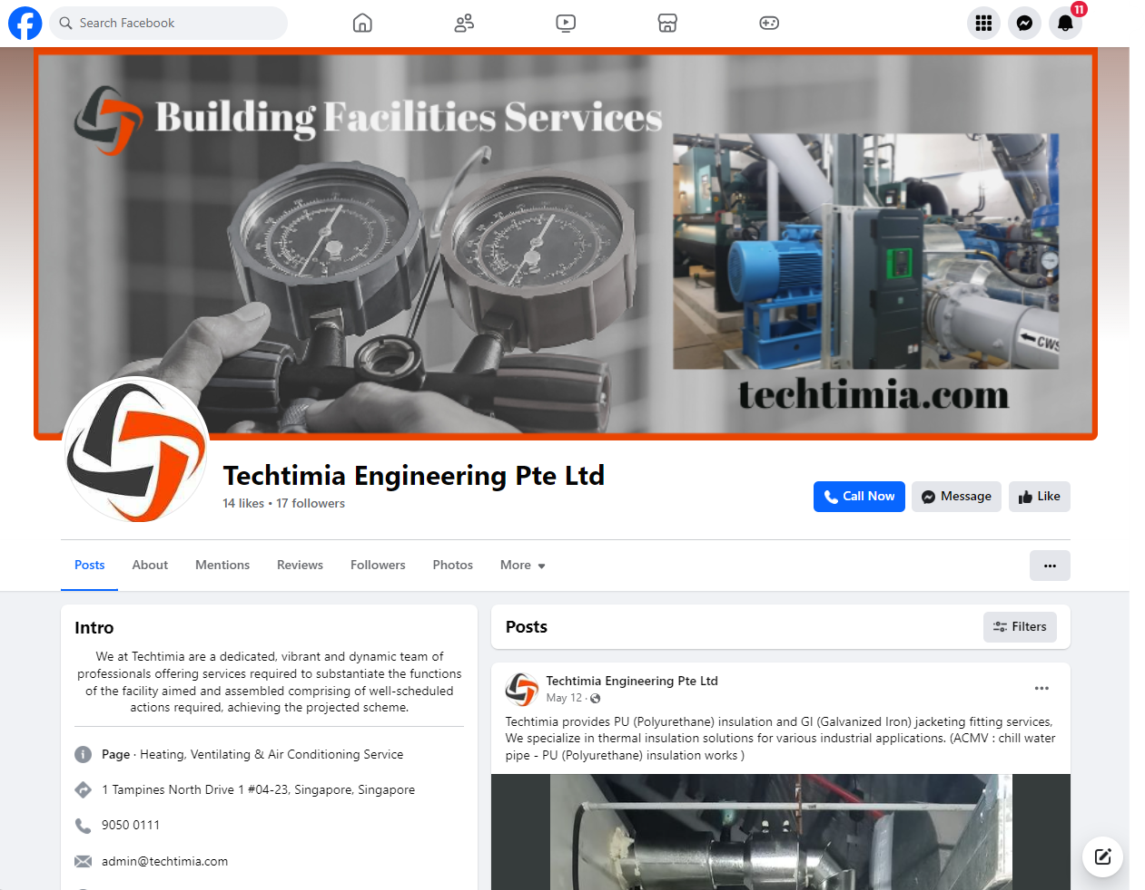


Competitive Analysis – Social media
Facebook
Guan Lee Hoe
vs
Paw Leck
All 3 companies have no active
Facebook ad campaigns
Techtimia

Slide 30
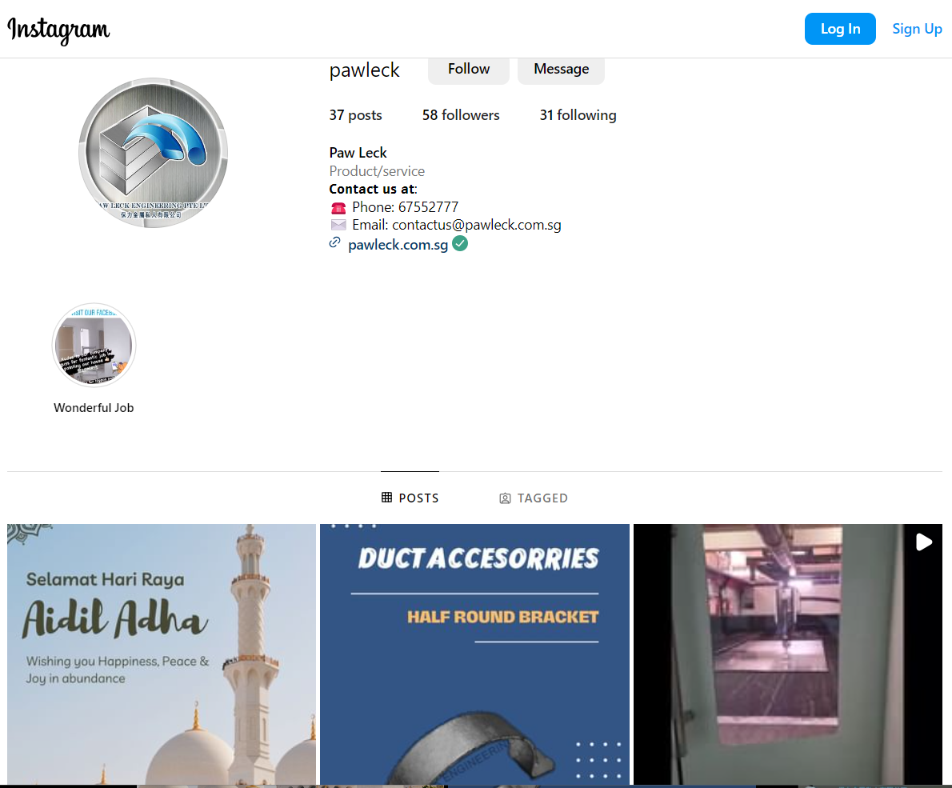
Competitive Analysis – Social media
Instagram
Guan Lee Hoe - no Instagram
Techtimia – no Instagram
Paw Leck Engineering

Slide 31
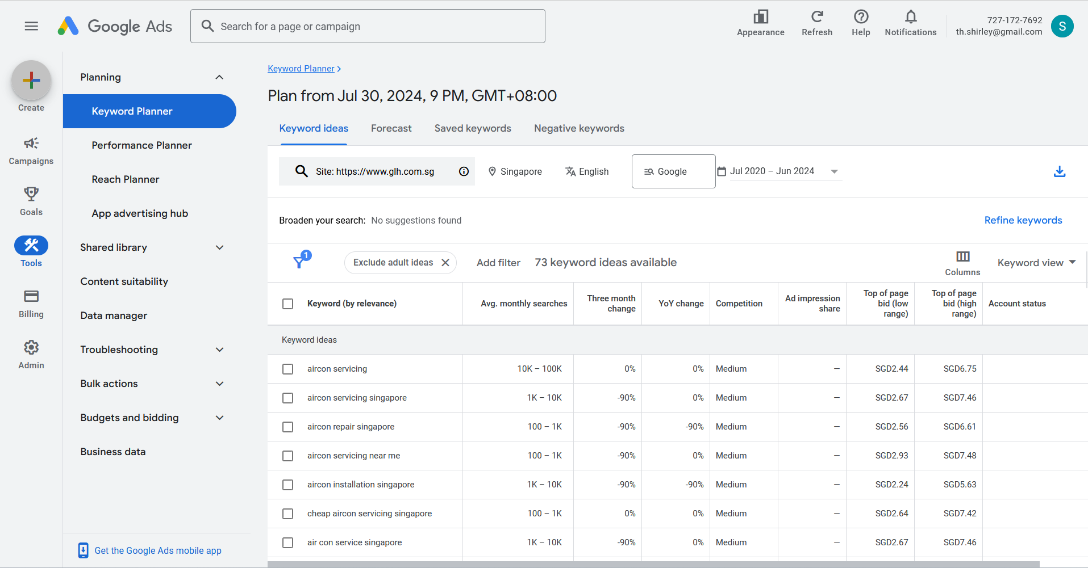
Competitive Analysis - Search Engine Marketing

Slide 32
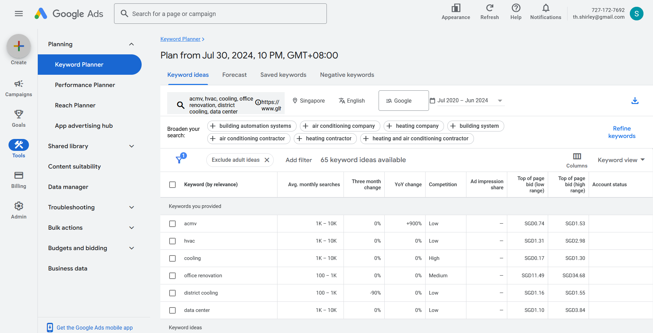
Competitive Analysis - Search Engine Marketing

Slide 33
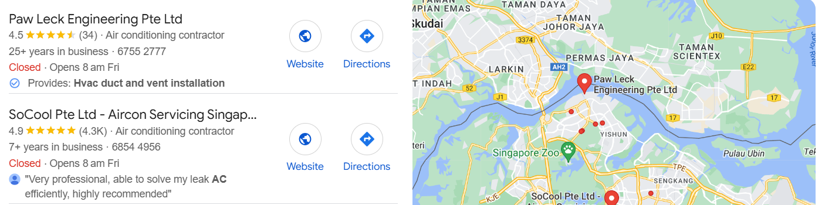
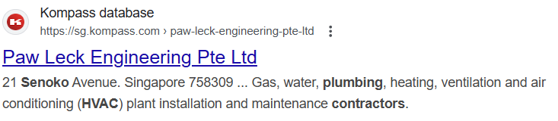
Competitive Analysis - Search Engine Marketing
Google Map recommendation
3rd Party recommendation

Slide 34
Competitive Analysis - Search Engine Marketing
Category | Area of comparison | https://www.glh.com.sg | https://pawleck.com.sg | https://www.techtimia.com
Keywords | Keyword Match Types (organic) | 4 keywords guan lee hoe engineering pte ltd hoe hoe engineering pte ltd hoe hoe engineering pte ltd guan lee hardware pte ltd | 229 keywords plenum box, ss316, metal perforated sheet, linear diffuser, stainless steel sheet | 71 keywords jacketing insulation, singapore cnc machine, aircon insulation, welding service, walk-in freezer
 | Targeted Keywords | 0 keywords | 0 keywords | 117 Keywords kitchen exhaust fan Singapore, nike quest 2, air flow, chiller room, 81 aircon pte ltd
Ad Copy | Headlines and Descriptions | At Guan Lee Hoe Engineering Pte Ltd, we specialize in air-con installation, servicing, repair and office renovation. | We offer a comprehensive suite of a one-stop supplier of ACMV products and services. Catering to our customers’ requirements in various fields. | safeguard your well-being With Techlimia. Call now to breathe easy With our duct services.
 | Unique Selling Propositions (USPs) | ACMV Installation and office renovation | Cutting edge machinery, R&D, teamwork | End to end of ACMV and other offerings Installation and Maintenance
Landing Pages | Page Design and Content | Bare | Comprehensive | Comprehensive
 | Call to Action (CTA) | Contact form | Contact form, WhatsApp | Contact form, WhatsApp

Slide 35
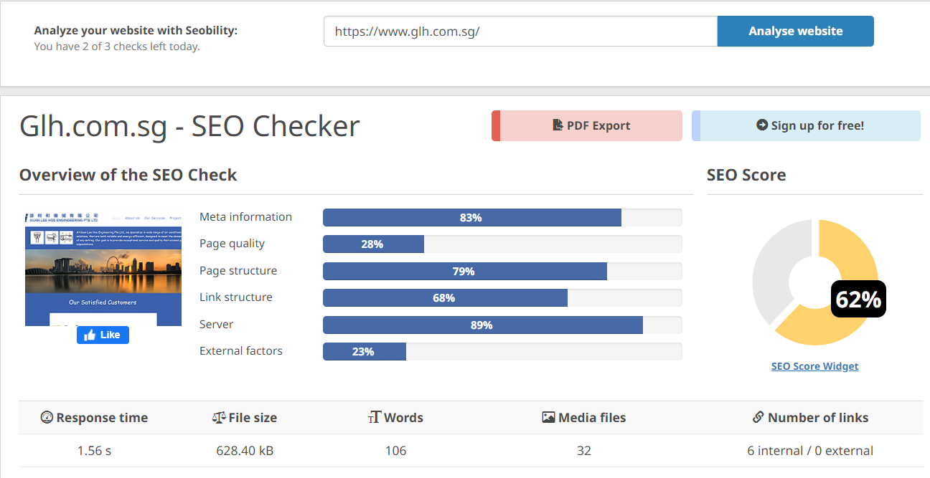
Website Optimisation
Optimized for SEO
Can be improved further

Slide 36
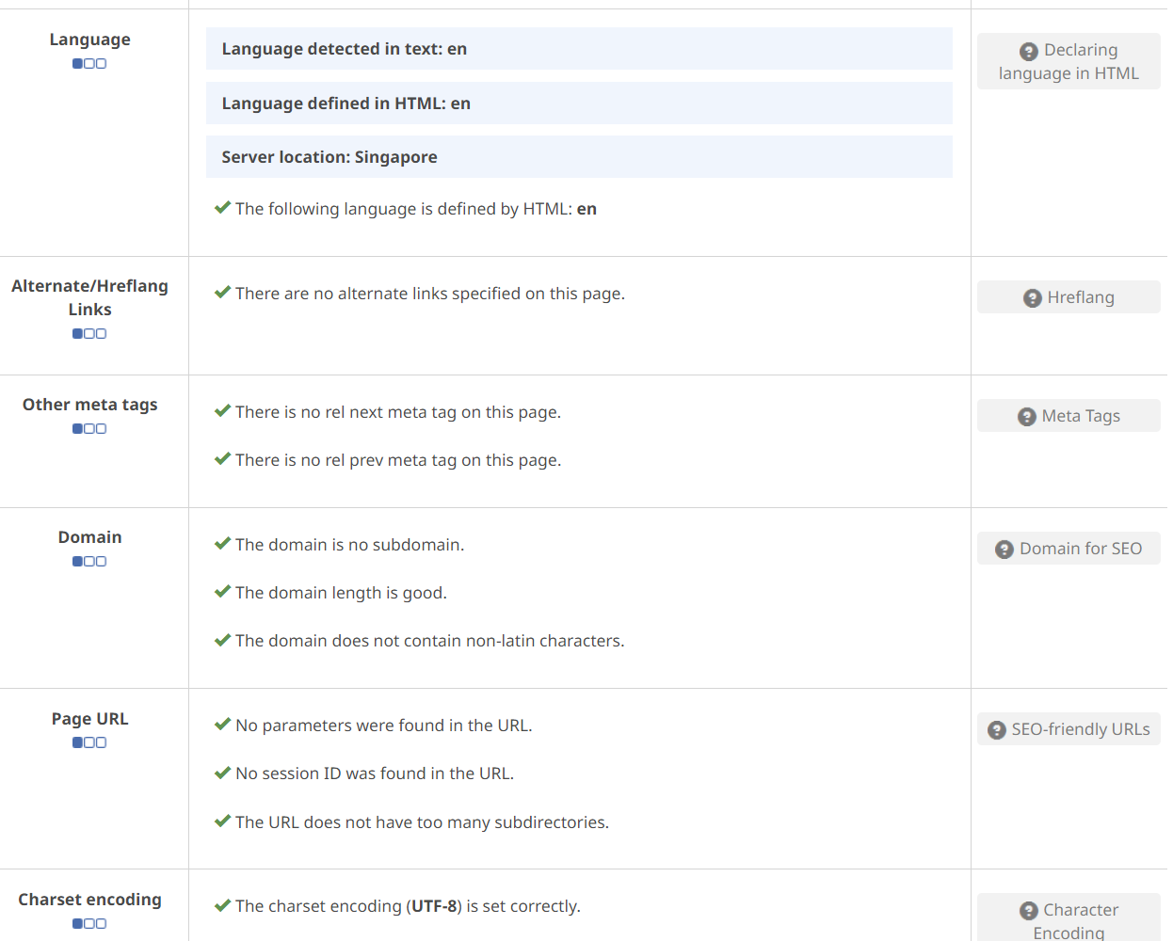
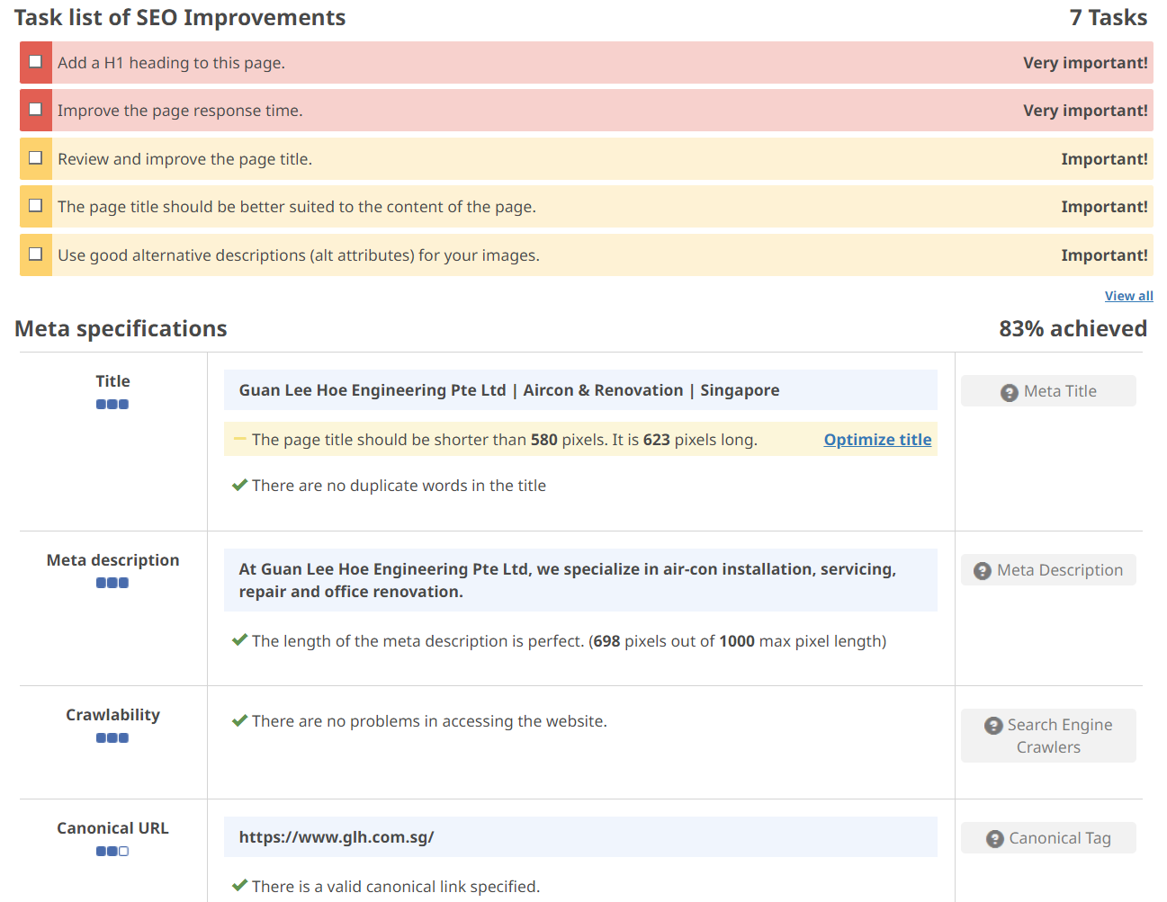
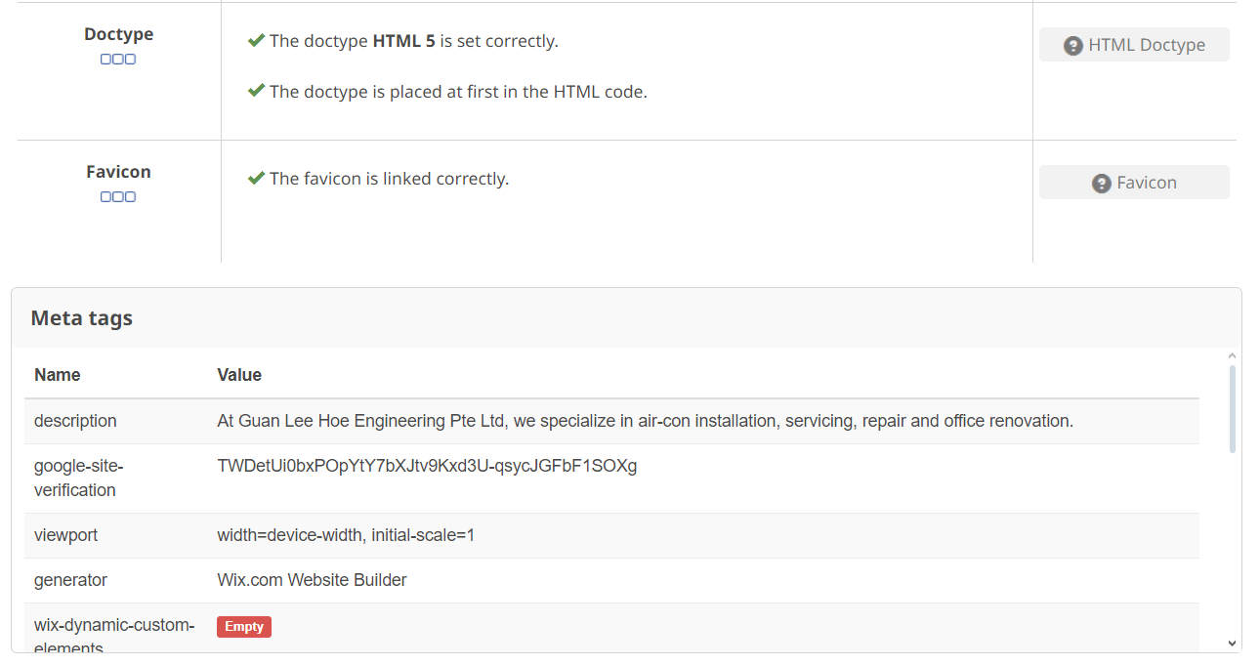
Website Optimisation
Detailed breakdown

Slide 37
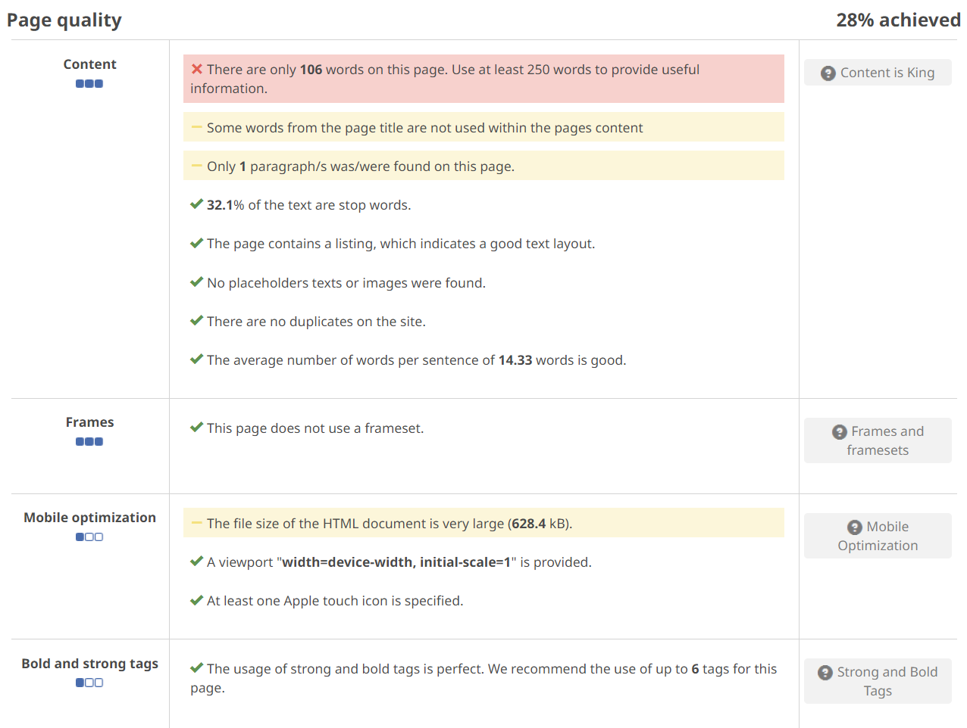
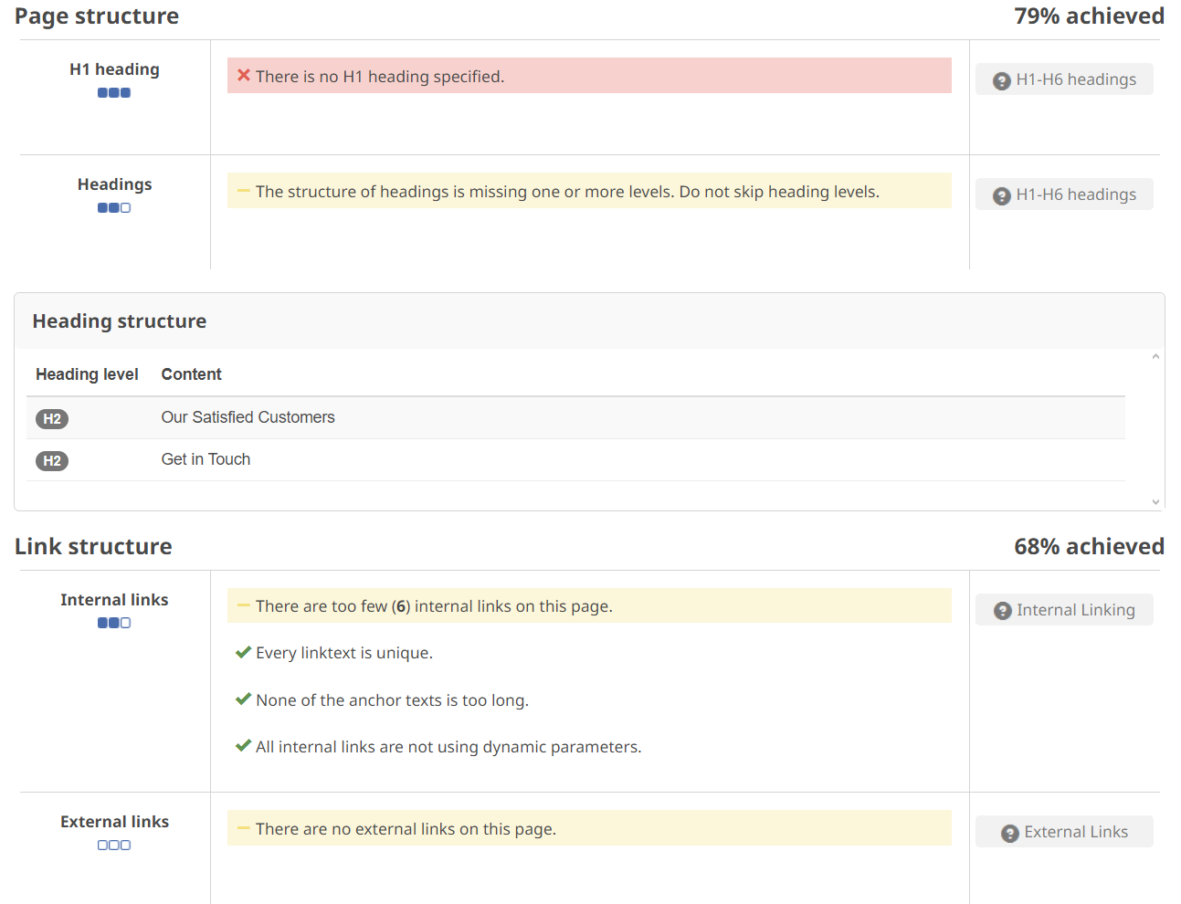
Website Optimisation
Flagged: number of words – Not significant

Slide 38
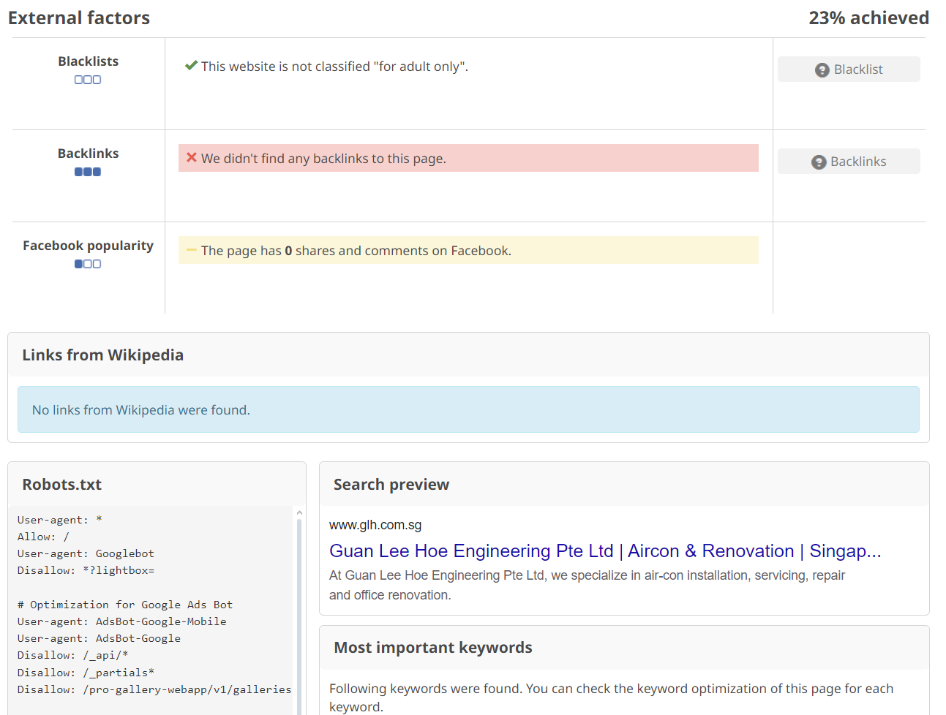
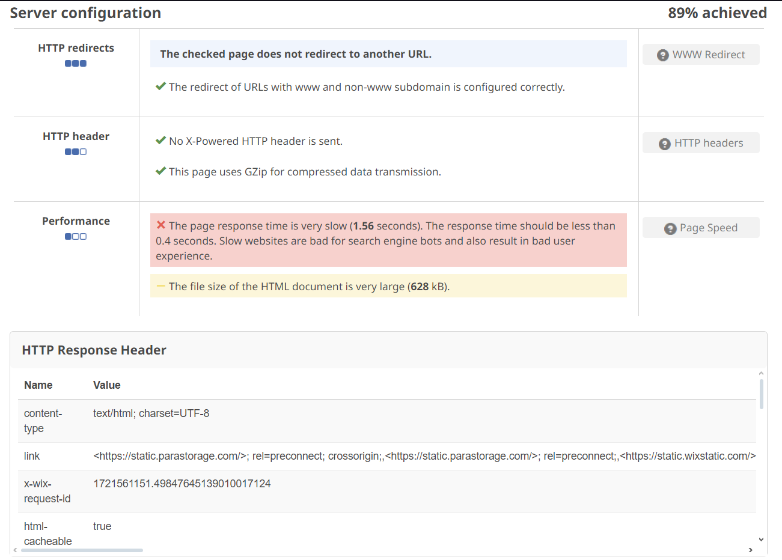
Website Optimisation
Flagged: webpage load speed – Can be improved
backlinks – Can be improved

Slide 39
Marketing Prioritization
High Impact | Costly to execute but potentially high impact, medium priority | Easy to execute and high impact, must be done, Top priority
 | Google advertisements | Facebook Instagram Landing Page
Low Impact | Costly to execute with low returns, do not execute | Easy to execute but not much impact on marketing results, low priority
 | Traditional advertising like TV or Print media Mass market events | Referral program
 | High Cost to Execute | Low Cost to Execute

Slide 40
Customer Journey (Content)
Customer Lifecycle Stage | Digital Marketing Channels | Content Ideas (Copywritten titles)
Awareness | SMM SEM SEO | Posts –“Benefits of upgrading to a new energy efficient aircon system” - “Green Mark certification for energy saving aircon system” - “Install ACMV, HVAC aircon system, speak to our experts” - “Stay cool with our HVAC, ACMV aircon system” - “Cooling Excellence with energy savings HVAC/ ACMV aircon system” - “Innovating Cooling Solutions with HVAC / ACMV aircon system”
Consideration | Landing Page Email Remarketing | “Master of commercial and industrial aircon systems since1995” “HVAC solutions – Innovative HVAC systems ensures that optimising climate controls and prioritising efficiency and sustainability” “Office renovation – Expert office renovation customise to meet your business needs and aesthetic preferences” “Testimonials – the team exceeded our expectation. Their expertise in HVAC aircon systems had transformed our work space” “Beat the Heat: Expert ACMV/HVAC Solutions from Guan Lee Hoe Engineering” “Cool Comfort Guaranteed: Guan Lee Hoe Engineering's Aircon Design, Installation & More” “Optimized Air Quality, Optimized Comfort: Guan Lee Hoe Engineering's ACMV/HVAC Expertise” “Don't Sweat It! Guan Lee Hoe Engineering's ACMV/HVAC Services Keep U Cool” “Guan Lee Hoe Engineering: Your One-Stop Shop for ACMV/HVAC Design, Installation, & Maintenance”

Slide 41
Customer Journey (Content)
Customer Lifecycle Stage | Digital Marketing Channels | Content Ideas (Copywritten titles)
Decision | Online Enquiries Phone Calls WhatsApp | Call us, Whats App or Contact Form

Slide 42
Marketing Funnel
Attention
01
Facebook, Instagram, Google Ads, Landing Page, Emails
Interest
02
Landing Page, Emails
03
Desire
Landing Page, Emails
Action
04
Landing Page, Google Ads

Slide 43
SMART Goals
Channel | Metric | KPI | Duration | Notes (if any)
Landing Page | No. of Landing Page Visitors | +20% | in 6 months time | Awareness and leads
 | No.of Calls to Action | +10% | in 6 months time | Asking for free site survey and /or consultation
Instagram | No. of Calls to Action | +15% | In 6 months time
Facebook | No. of Likes & Followers | +15% | In 6 months time | Active posting for organic leads
Emails | No. of Calls to Action | +10% | In 6 months time | Asking for site survey and/or consultation

Slide 44
Marketing Execution

Slide 45
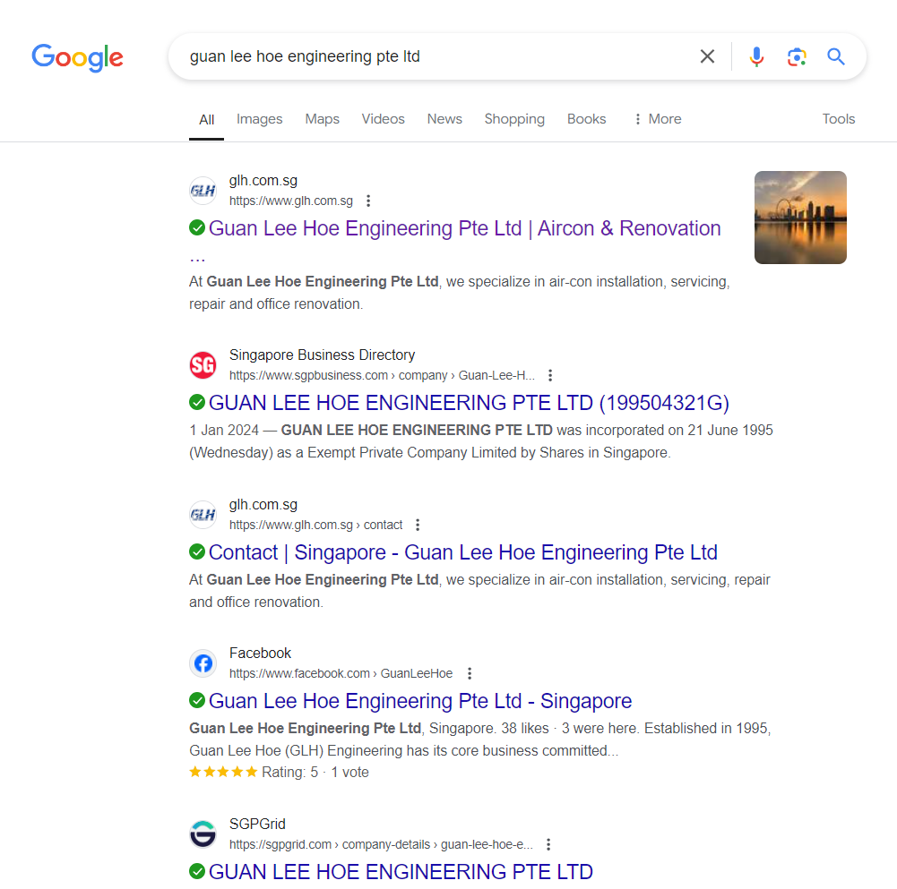
SEM - Google Search Ads

Slide 46
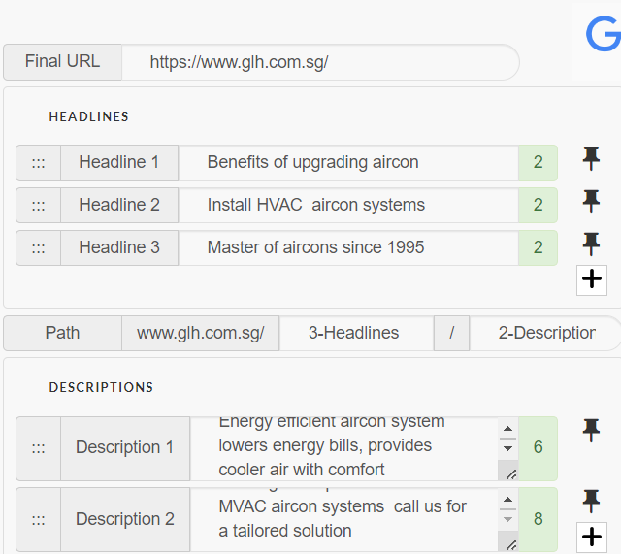
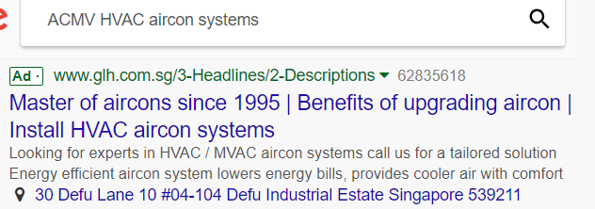
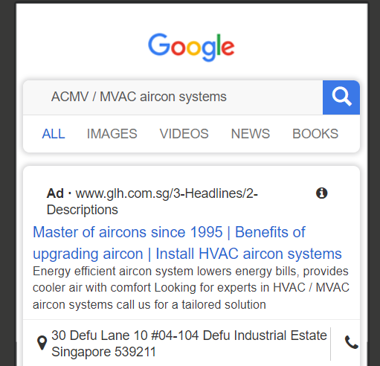
SEM - Google Search Ads (Ad mockups)

Slide 47
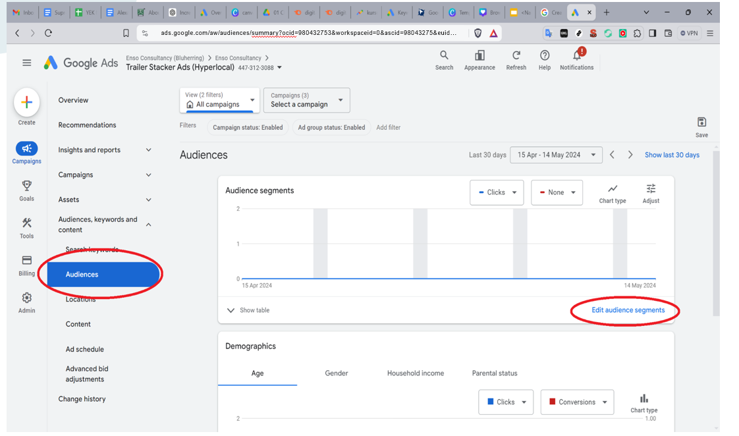
SEM - Google Search Ads (Target) Audience)

Slide 48
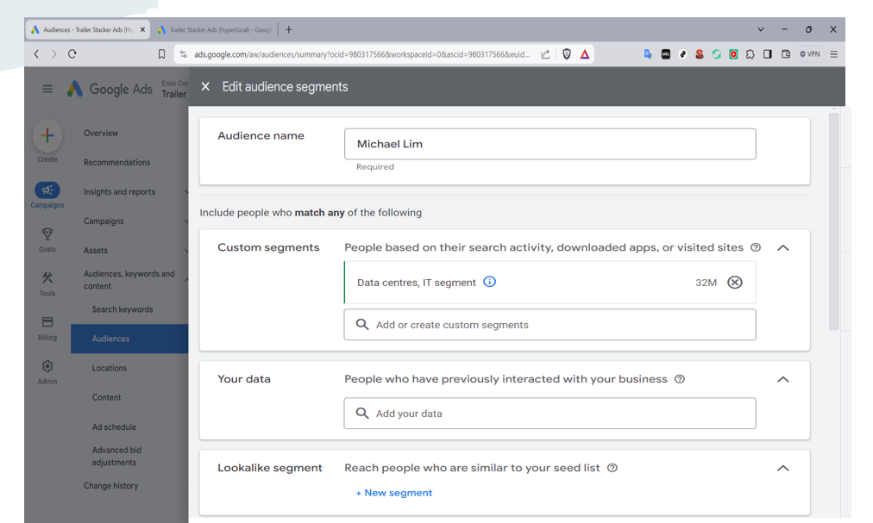
SEM - Google Search Ads (Target Audience)

Slide 49



Search Engine Marketing (Google Display Network Ads)
▼Mobile banner ad
▲ Half page ad
▼Billboard banner ad

Slide 50
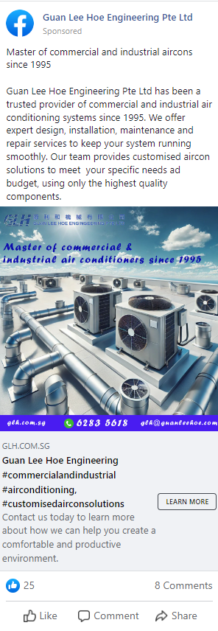
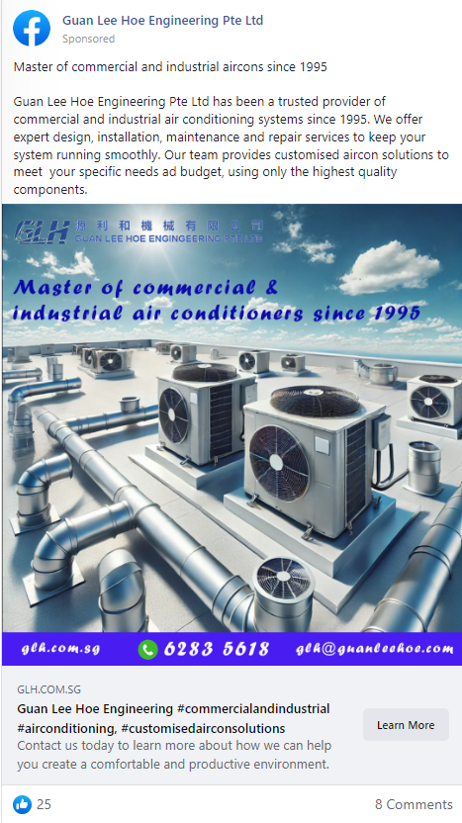
Social Media Marketing (Organic Post)
Desktop
Mobile

Slide 51
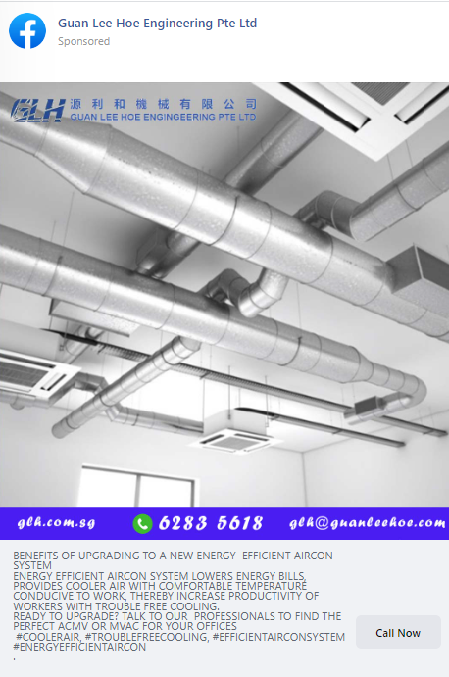
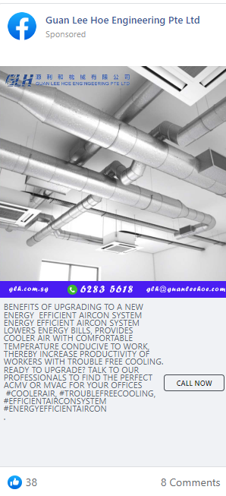
Social Media Marketing (Organic Post)
Desktop
Mobile

Slide 52
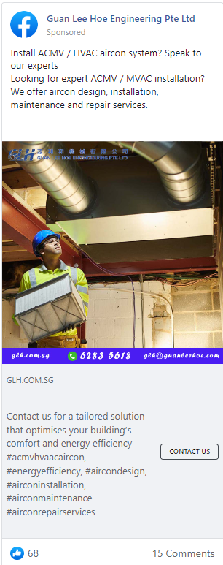
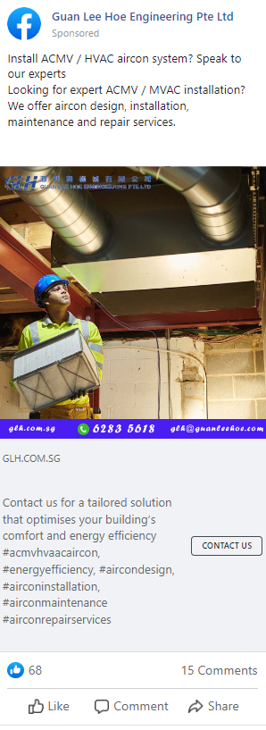
Social Media Marketing (Organic Post)
Desktop
Mobile

Slide 53
Social Media Marketing (Organic Post)
Content writing for Facebook
Master of commercial and industrial aircons since 1995
Guan Lee Hoe Engineering Pte Ltd has been a trusted provider of commercial and industrial air conditioning systems since 1995. We offer expert design, installation, maintenance and repair services to keep your system running smoothly. Our team provides customised aircon solutions to meet your specific needs ad budget, using only the highest quality components.
Contact us today to learn more about how we can help you create a comfortable and productive environment.
#guanleehoeengineering, #commercialandindustrialairconditioning, #customisedairconsolutions
2. Benefits of upgrading to a new energy efficient aircon system
Energy efficient aircon system lowers energy bills, provides cooler air with comfortable temperature conducive to work, thereby increase productivity of workers with trouble free cooling.
Ready to upgrade? Talk to our professionals to find the perfect ACMV or MVAC for your offices
#coolerair, #troublefreecooling, #efficientairconsystem #energyefficientaircon

Slide 54
Social Media Marketing (Organic Post)
3. Install ACMV / HVAC aircon system? Speak to our experts
Looking for expert ACMV / MVAC installation? We offer aircon design, installation, maintenance and repair
services
Contact us for a tailored solution that optimises your building’s comfort and energy efficiency
#acmvhvaacaircon, #energyefficiency, #aircondesign, #airconinstallation, #airconmaintenance
#airconrepairservices

Slide 55
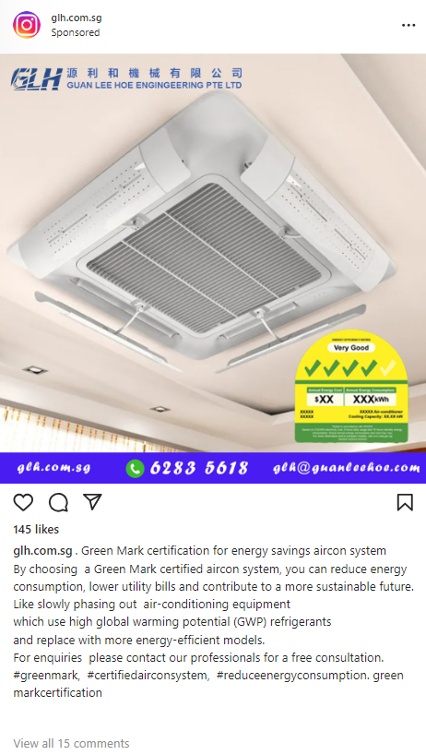
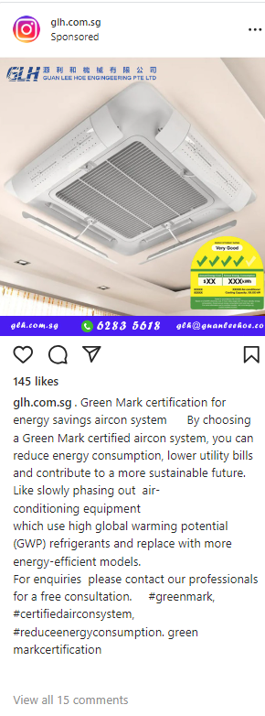
Social Media Marketing (Organic Post)
Desktop
Mobile

Slide 56
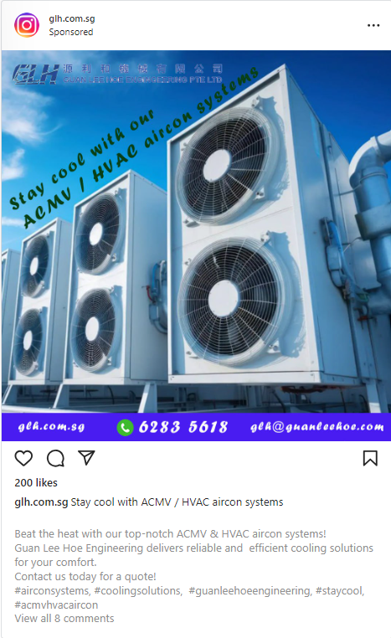
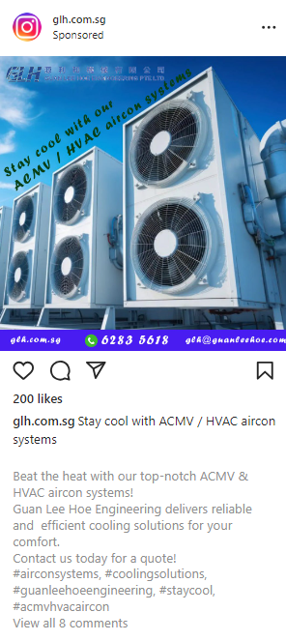
Social Media Marketing (Organic Post)
Desktop
Mobile

Slide 57
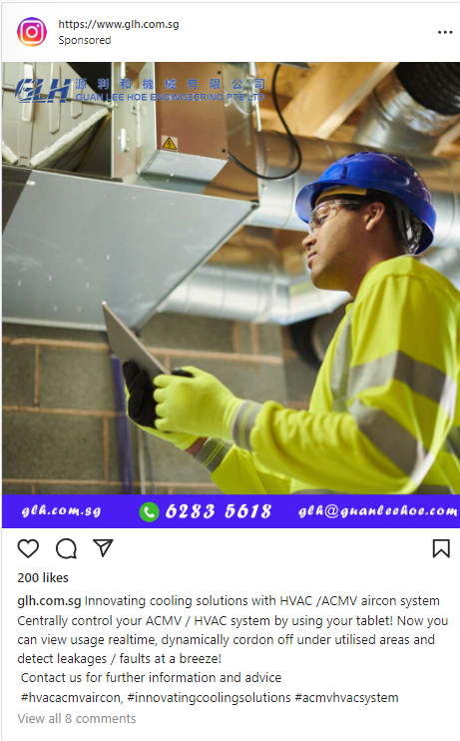
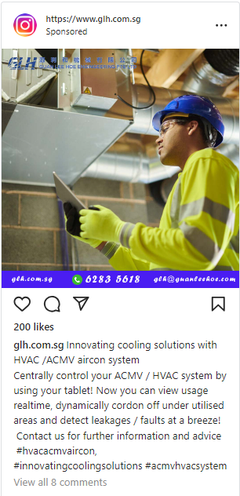
Social Media Marketing (Organic Post)
Desktop
Mobile

Slide 58
Social Media Marketing (Organic Post)
Content writing for Instagram
1. Green Mark certification for energy savings aircon system
It is a prestigious recognition awarded in Singapore for environmentally friendly products.
It signifies that the aircon system meets strict energy efficient standards set by BCA.
By choosing a Green Mark certified aircon system, the client can reduce energy consumption, lower utility bills and contribute to a more sustainable future. For instance, it slowly phased out refrigeration and air-conditioning equipment that use high global warming potential (GWP) refrigerants and replaced electrical and water appliances with more energy-efficient models. For enquiries please contact our professionals for a free consultation.
#greenmark, #certifiedairconsystem, #reduceenergyconsumption
2. Stay cool with our ACMV / HVAC aircon systems
Beat the heat with our top-notch ACMV & HVAC aircon systems!
Guan Lee Hoe Engineering delivers reliable and efficient cooling solutions for your comfort.
Contact us today for a quote!
#airconsystems, #coolingsolutions, #guanleehoeengineering, #staycool, #acmvhvacaircon

Slide 59
Social Media Marketing (Organic Post)
Content writing for Instagram
3. Innovating cooling solutions with HVAC /ACMV aircon system
Centrally control your ACMV / HVAC system by using your tablet! Now you can view usage realtime, dynamically cordon off under utilised areas and detect leakages / faults at a breeze!
Contact us for further information and advice
#hvacacmvaircon, #innovatingcoolingsolutions #acmvhvacsystem

Slide 60
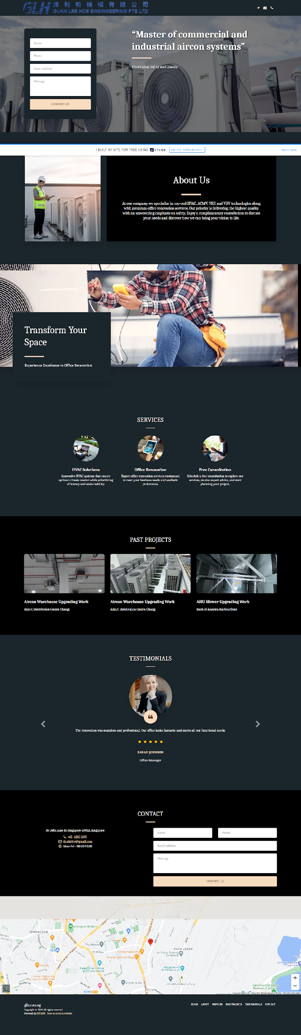
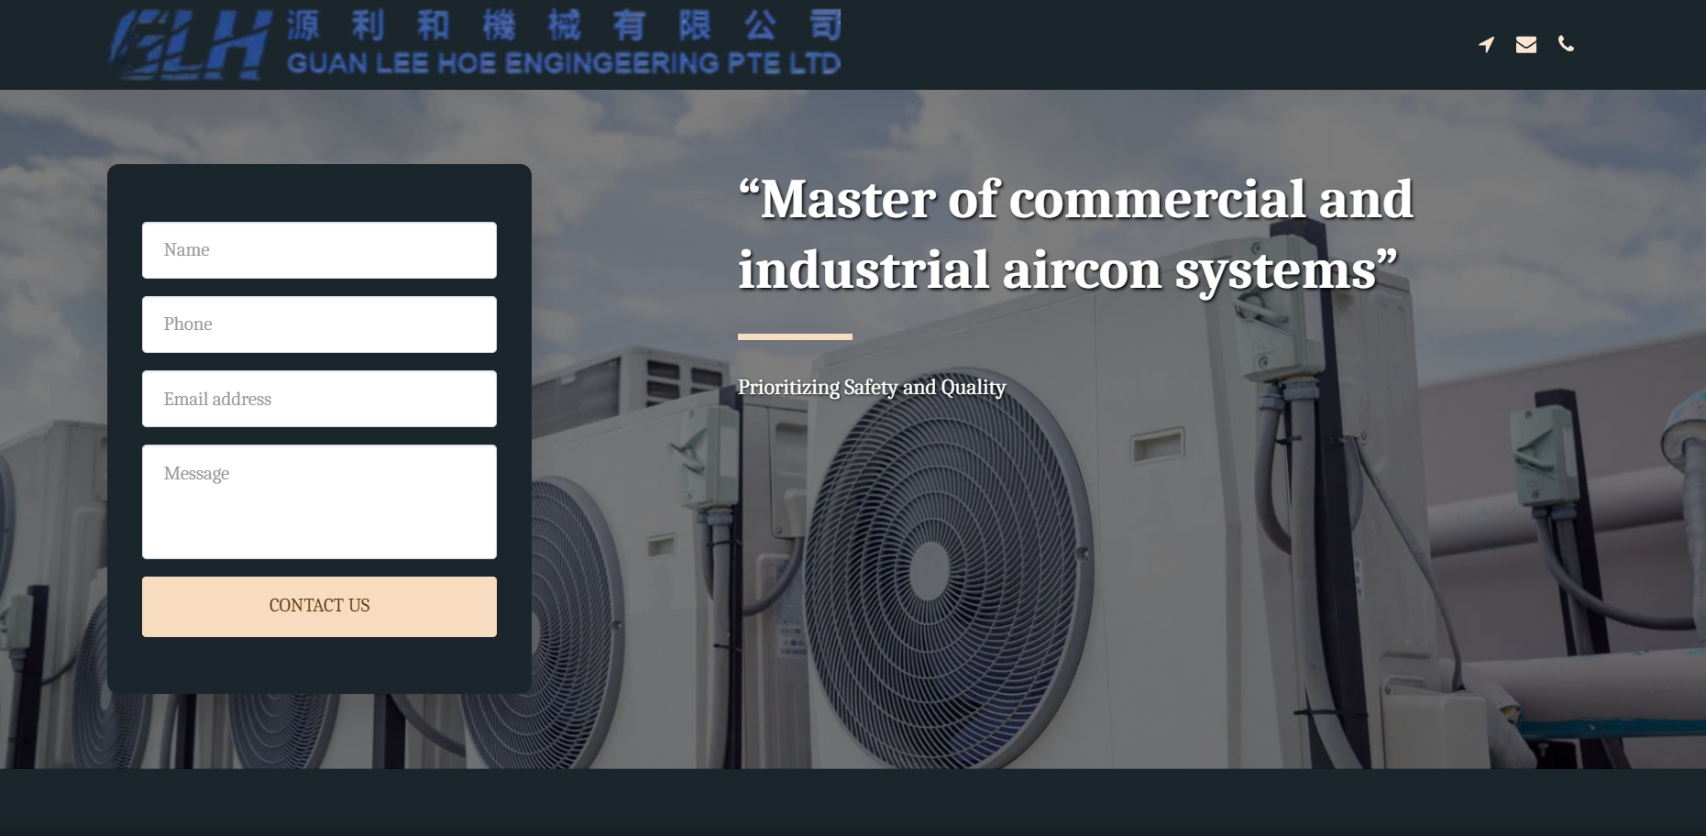
Landing Page (Desktop Published)
https://66b9233492ab8.site123.me/

Slide 61
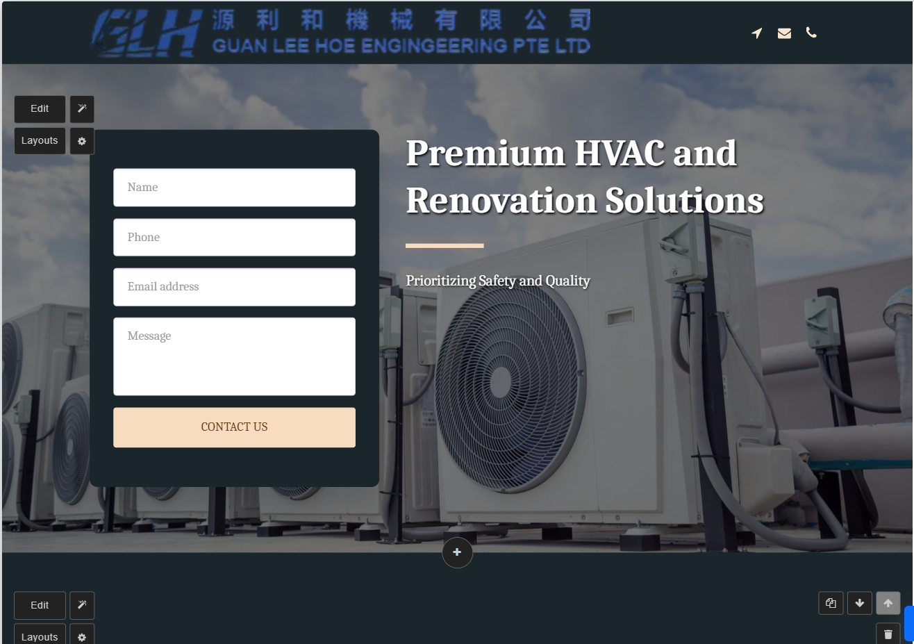
Landing Page (Desktop Published)

Slide 62
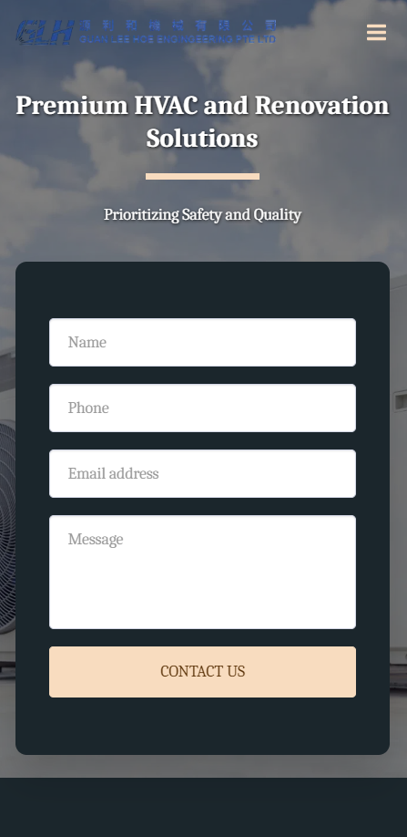
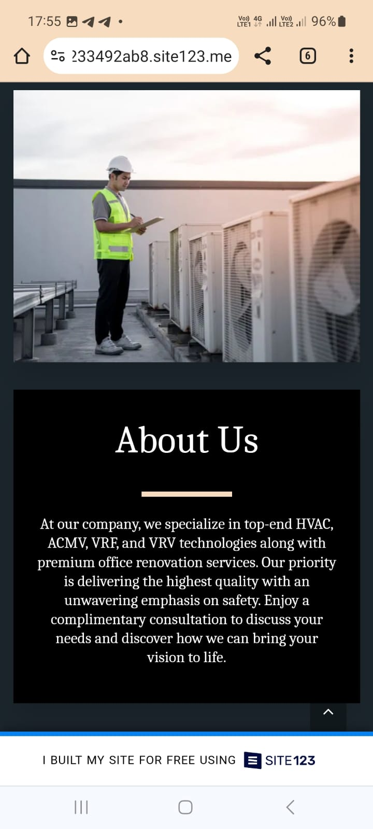
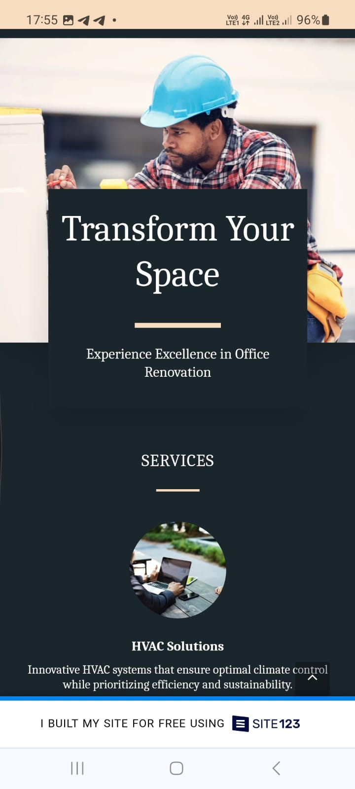

Landing Page (Mobile Published)

Slide 63



Landing Page (Mobile Published)

Slide 64
Email Marketing
# | Content of email | Call To Action in Email
1 | Beat the Heat: Expert ACMV/HVAC Solutions from Guan Lee Hoe Engineering | Phone call /ContactForm
2 | Cool Comfort Guaranteed: Guan Lee Hoe Engineering's Aircon Design, Installation & More | Phone call /ContactForm
3 | Optimized Air Quality, Optimized Comfort: Guan Lee Hoe Engineering's ACMV/HVAC Expertise | Phone call /ContactForm
4 | Don't Sweat It! Guan Lee Hoe Engineering's ACMV/HVAC Services Keep U Cool | Phone call /ContactForm
5 | Guan Lee Hoe Engineering: Your One-Stop Shop for ACMV/HVAC Design, Installation, & Maintenance | Phone call /ContactForm
6 | Upgrade Your Aircon System: Get a Free Consultation from Guan Lee Hoe Engineering | Phone call /ContactForm
7 | Prevent AC Breakdowns: Schedule Your Regular ACMV / HVAC Maintenance with Guan Lee Hoe Engineering | Phone call /ContactForm
8 | Need a New Aircon System? Guan Lee Hoe Engineering Offers Expert Design & Installation | Phone call /ContactForm
9 | Is Your Aircon Running Inefficiently? Guan Lee Hoe Engineering Can Help You Save Money | Phone call /ContactForm

Slide 65

Email Marketing

Slide 66
The End

